Slide 1


Title: Airbnb Listings Data Analysis
Subtitle: Exploratory Data Analysis of Airbnb Listing
Prepared by: MD Nur Hossain Joy
Tools: Python | Pandas | NumPy | Matplotlib | Seaborn

Slide 2
Project Overview
Content:
Analysis of Airbnb listing data
Dataset contains property, host, location, pricing, reviews and availability information
Focus on data cleaning and exploratory analysis
Analysis performed using Python
Dataset Snapshot:
Metric | Value
Initial Records | 20,770
Initial Columns | 22
Final Records | 20,724
Final Columns | 23*

Slide 3
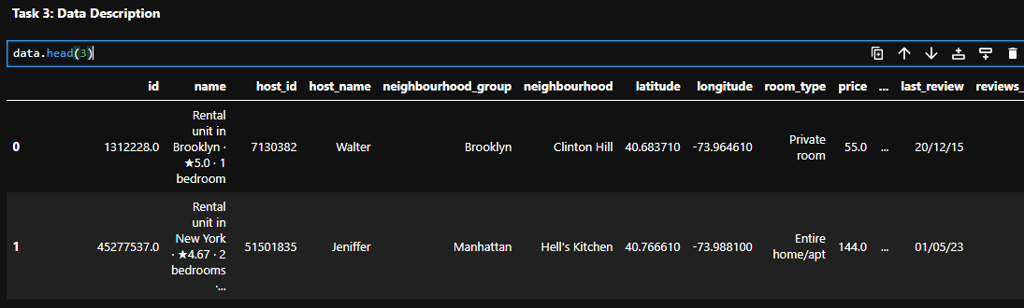
Task 3: Data description

Slide 4
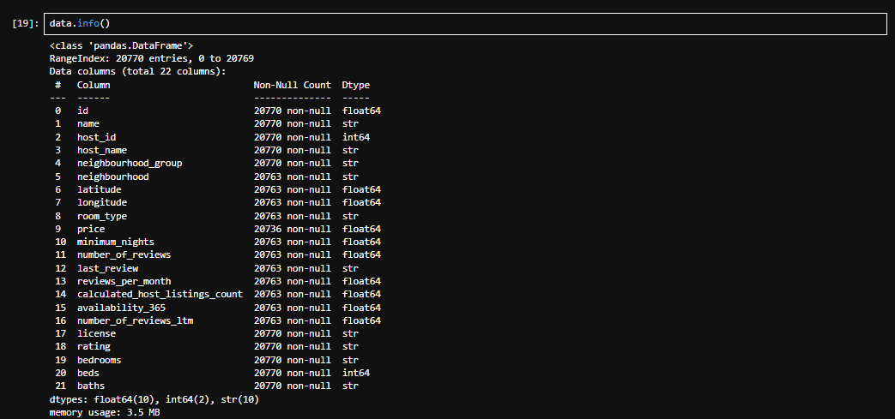
Task 3: Data description

Slide 5
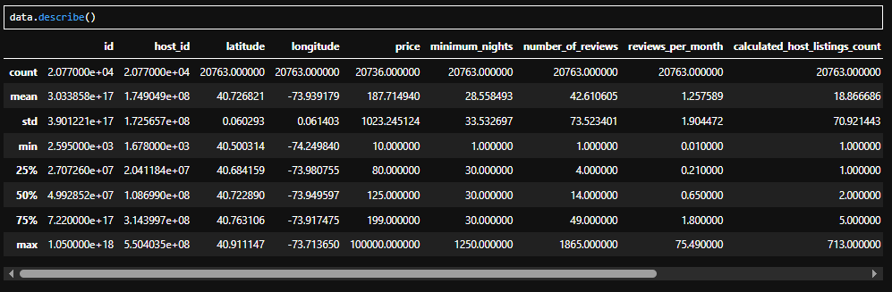
Task 3: Data description

Slide 6
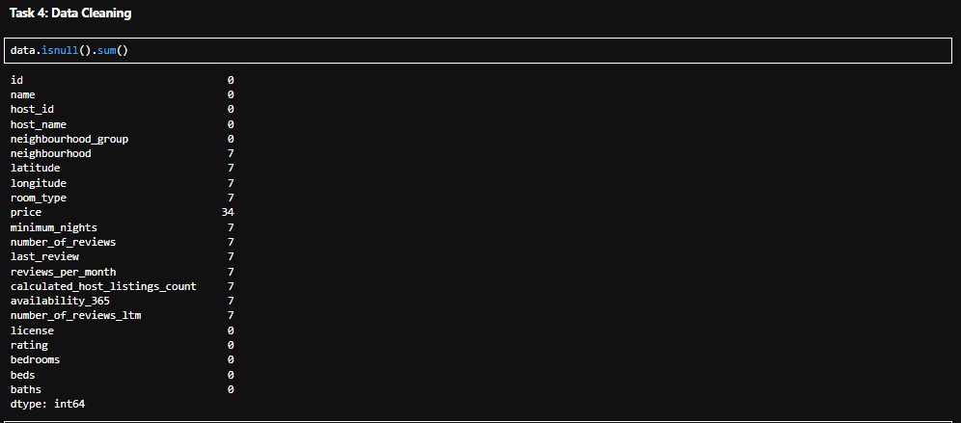
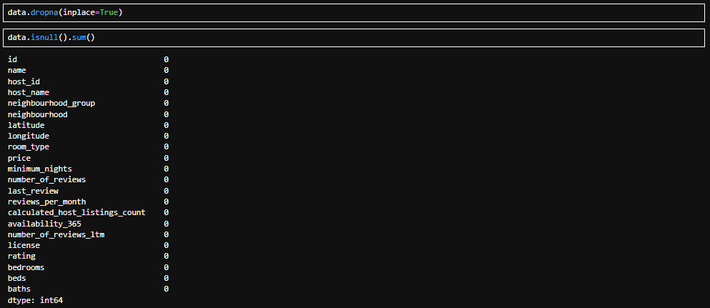
Task 4: Data Cleaning

Slide 7
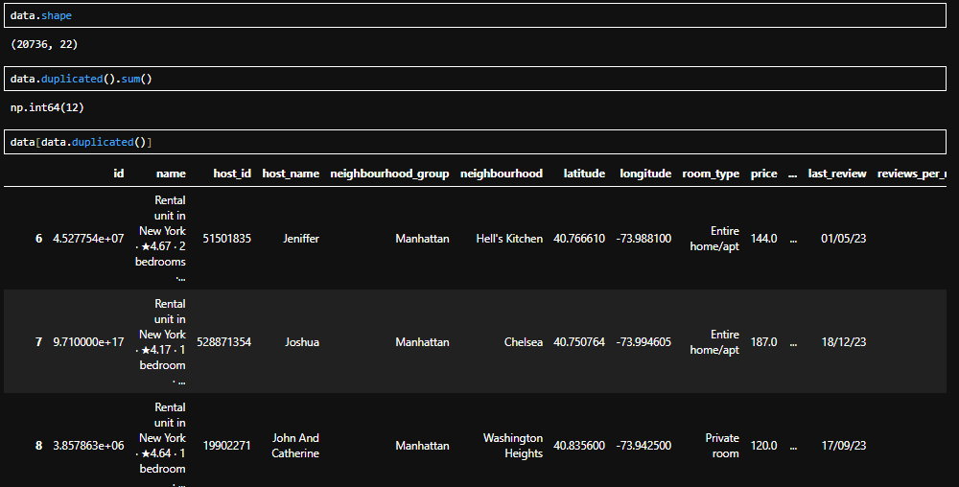
Task 4: Data Cleaning

Slide 8
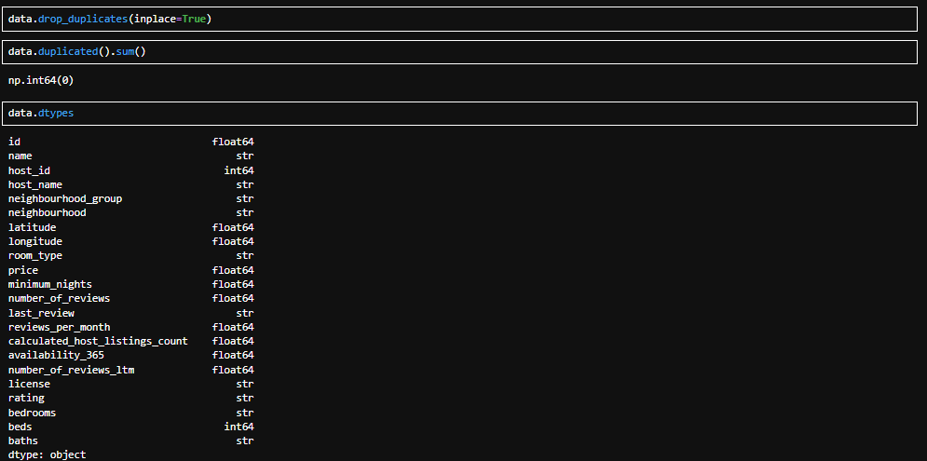
Task 4: Data Cleaning

Slide 9
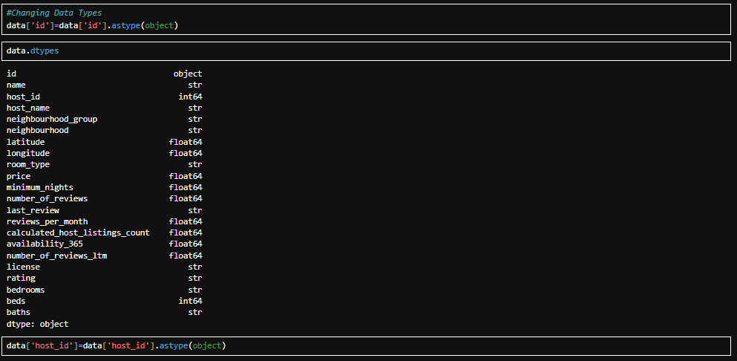
Task 4: Data Cleaning

Slide 10
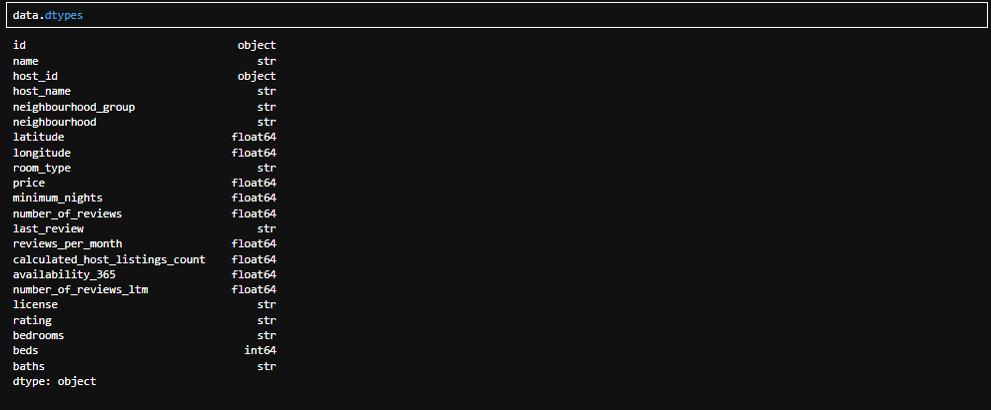
Task 4: Data Cleaning

Slide 11
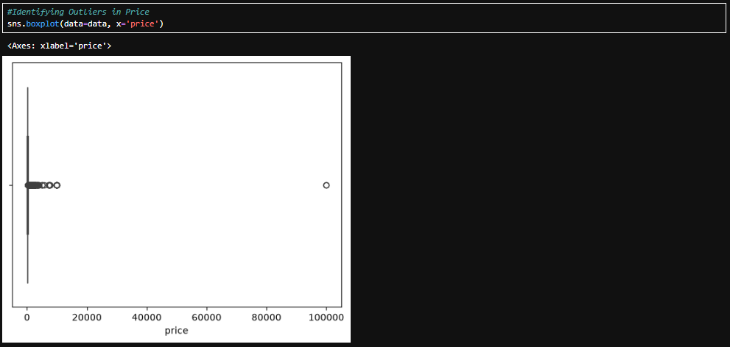
Task 5: Data Analysis-Univariate Analysis

Slide 12
Task 5: Data Analysis-Univariate Analysis

Slide 13
Task 5: Data Analysis-Univariate Analysis

Slide 14
Task 5: Data Analysis-Univariate Analysis

Slide 15
Task 5: Data Analysis-Univariate Analysis

Slide 16
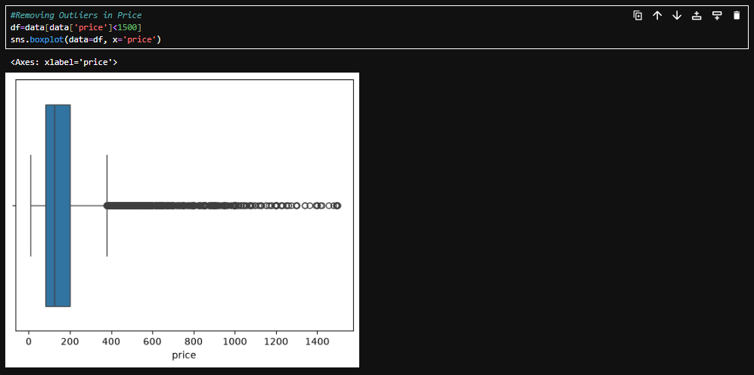
Task 5: Data Analysis-Univariate Analysis

Slide 17
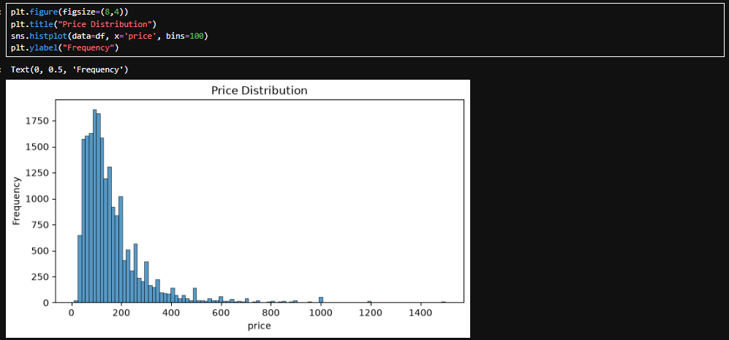
Task 5: Data Analysis-Univariate Analysis
Price Distribution

Slide 18
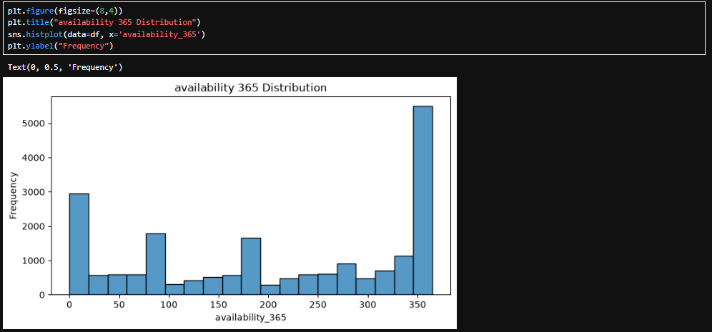
Task 5: Data Analysis-Univariate Analysis
Availability 365 Distribution

Slide 19
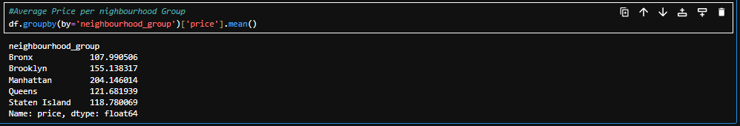
Task 5: Data Analysis-Univariate Analysis

Slide 20
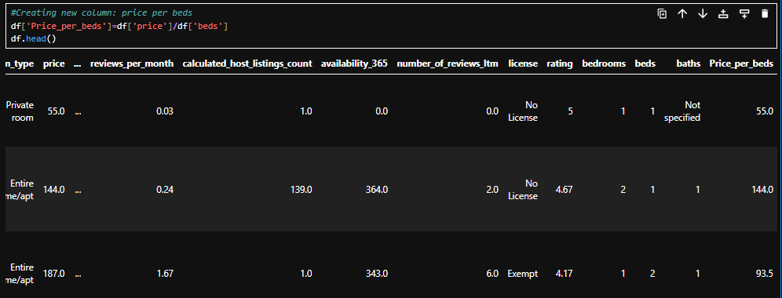
Task 5: Data Analysis-Univariate Analysis

Slide 21
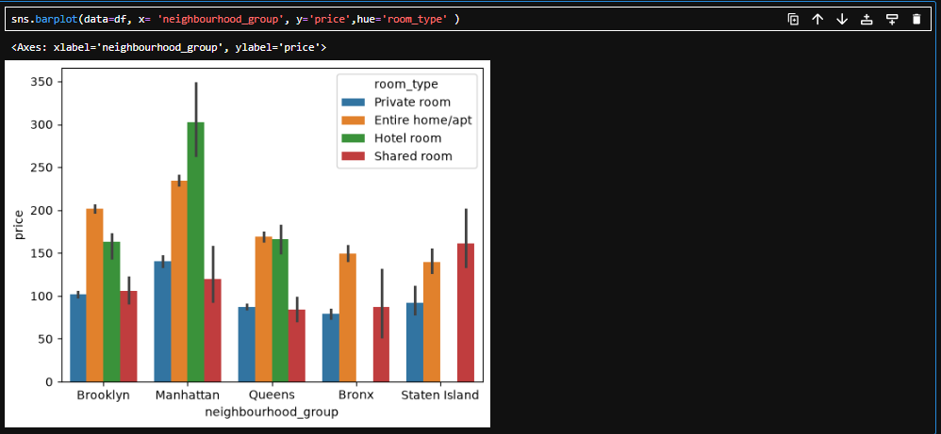
Task 5: Data Analysis-Bi Variable Analysis: One variable dependency in another variable

Slide 22
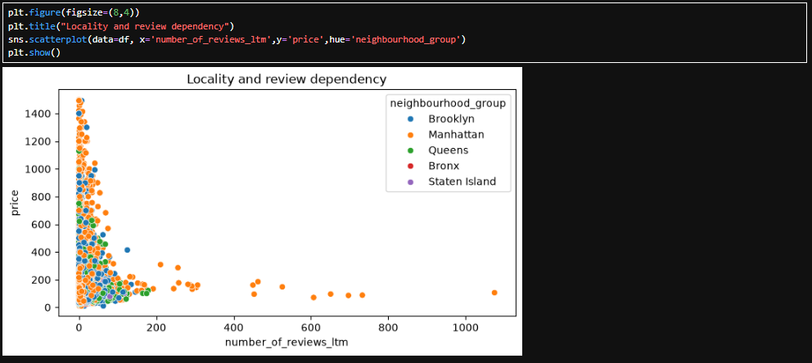
Task 5: Data Analysis-Bi Variable Analysis: One variable dependency in another variable

Slide 23
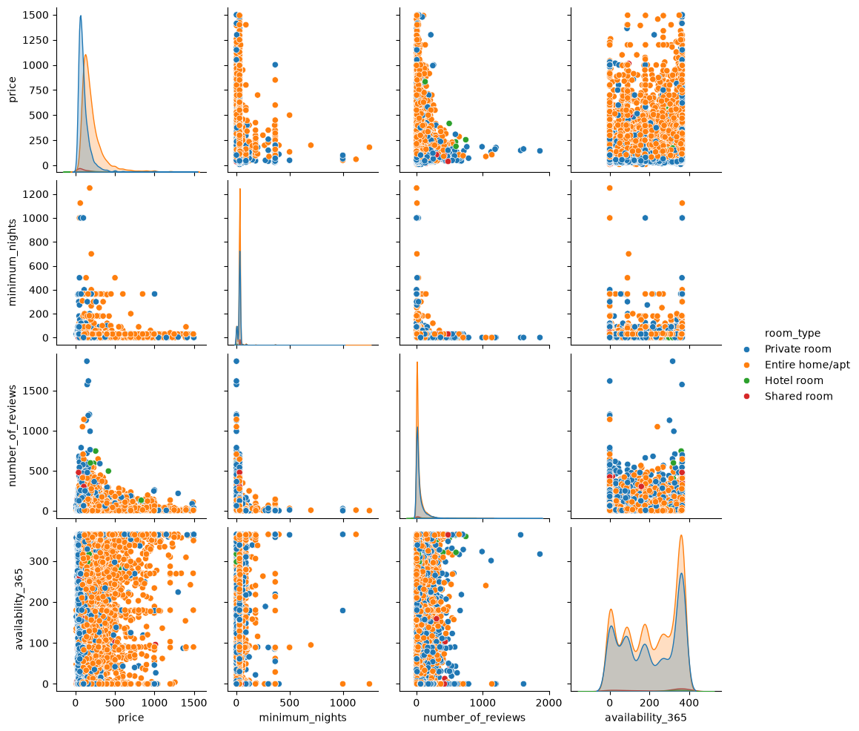
Task 5: Data Analysis-Bi Variable Analysis: One variable dependency in another variable

Slide 24
Task 5: Data Analysis-Bi Variable Analysis: One variable dependency in another variable

Slide 25
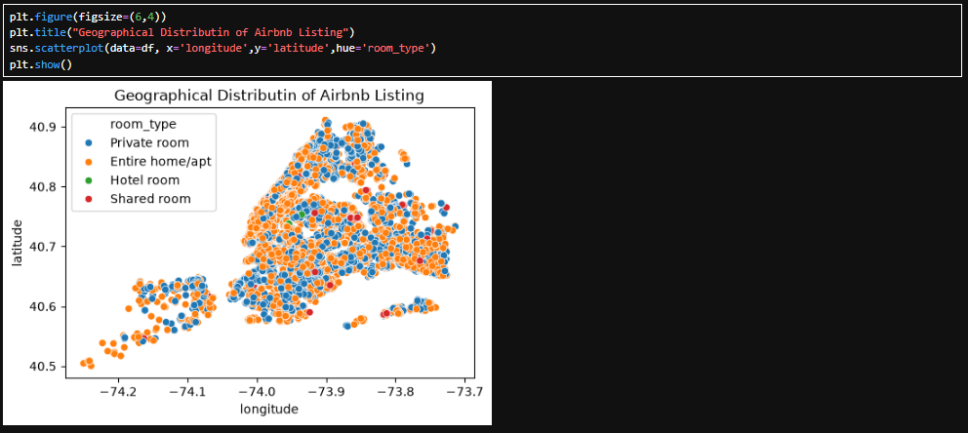
Task 5: Data Analysis-Bi Variable Analysis: One variable dependency in another variable

Slide 26
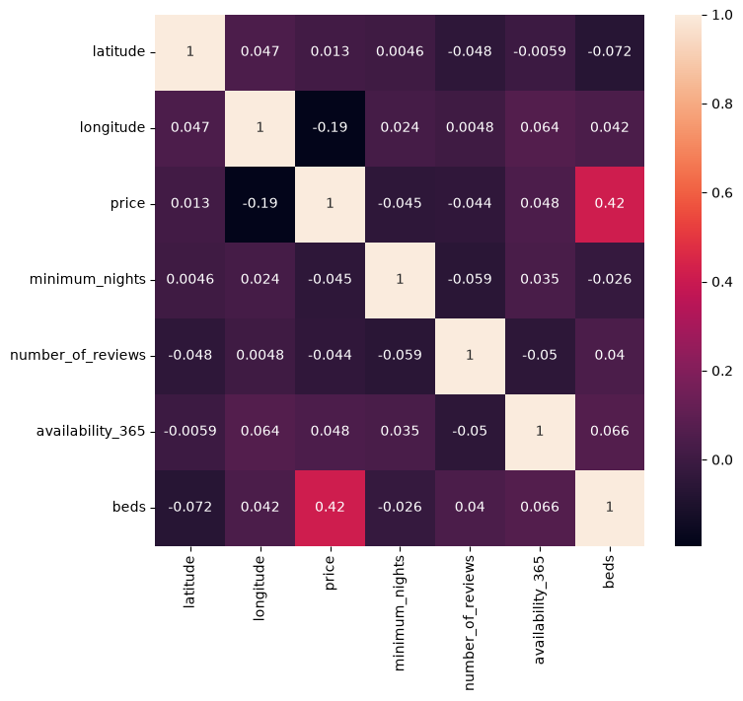
Task 5: Data Analysis-Bi Variable Analysis: One variable dependency in another variable

Slide 27
End of Project

